Slide 1

01/09 2022 Meeting
Sjur Beyer

Slide 2
Plan for this meeting
Go through the methods, available data, geological context

Slide 3
Why use Machine Learning?
The seismic inversion algorithm is slow
I want to

Slide 4
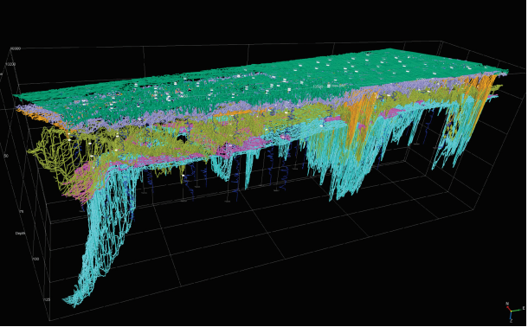
Ten noorden van de Waddeneilanden WFZ
Seismic data has been through seismic inversion
Good ground truth basis for training and testing
NGI has provided a machine learning deliverable for the project
Good grounds for comparison

Slide 5
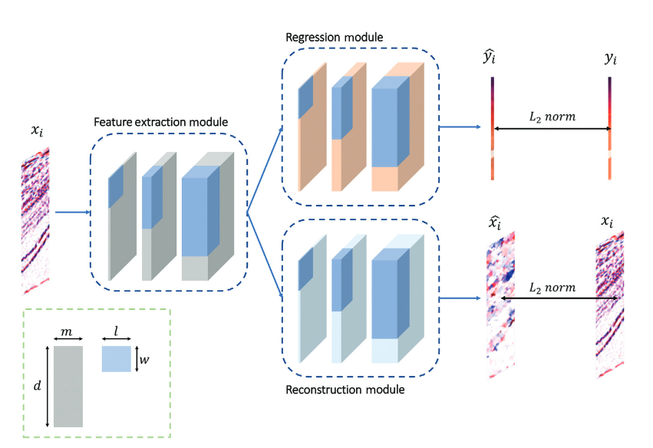
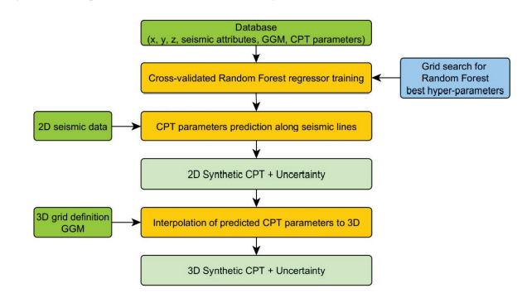
Project

Slide 6
Timeline of work
New updates will come regularly

Slide 7
Resources (digital infrastructure)
Tensorflow.keras for the ML
There is a github repository which will have alle the updated files
If you want access to the repo, I must add you as a contributor
Github issues, and work log
For writing I will use Overleaf:
https://www.overleaf.com/read/tzwckfrpfbvw
For citations I will be using Zotero

Slide 8
My expectations of you

Slide 9
My promises to you
I will be managing my time between different activities
Student assistant position during the fall semester
Playing in the revy band, and maybe elsewhere some days

Slide 10
Mutual expectation
Make notes of items of discussion, so they’re not lost
Use the discussion board on Teams
Respect each others time [wrt. work hours]. Includes notifying about not being available for meetings and respecting time for deliveries.

Slide 11
Groups and meetings

Slide 12
Next meeting

